Slide 1
CSE 320 /EEE 361 Data Communications
Introduction

Slide 2
Internet Applications (January 2019)
Internet Users
4.1B users worldwide
49% in Asia
Web
1.94 B – Number of websites.
51.8% of all traffic comes from bots not humans.
Google Search
7B search queries per day.
Email
14 B emails sent in a day.
Domain Name
342 million domain name registered.
‹#›

Slide 3
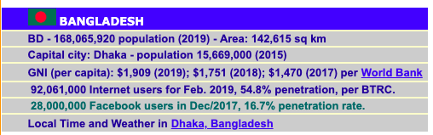
Bangladesh Internet Statistics (2019)
Source; http://www.internetworldstats.com/

Slide 4
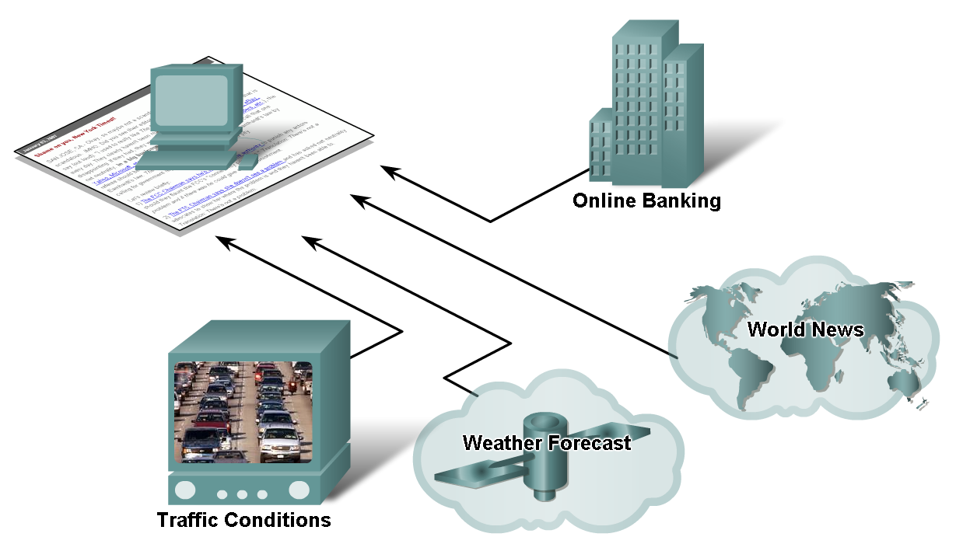
Networks supporting the way we live.

Slide 5
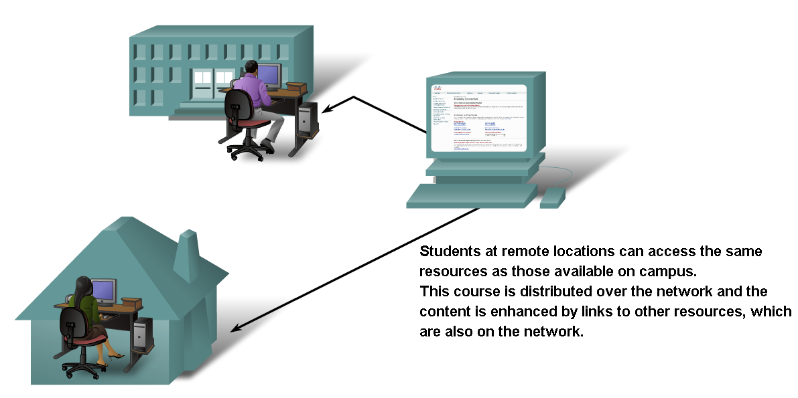
Networks supporting the way we learn.

Slide 6
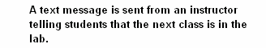

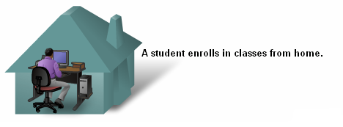

Networks supporting the way we learn.

Slide 7
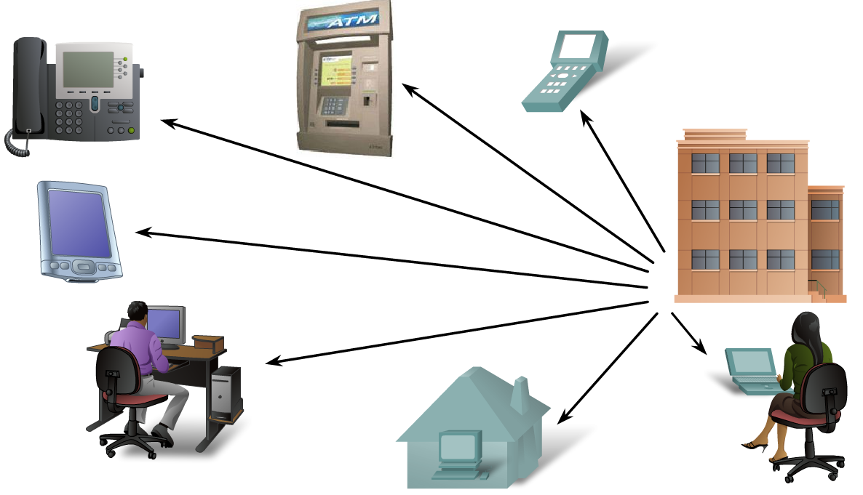
Networks supporting the way we work.

Slide 8
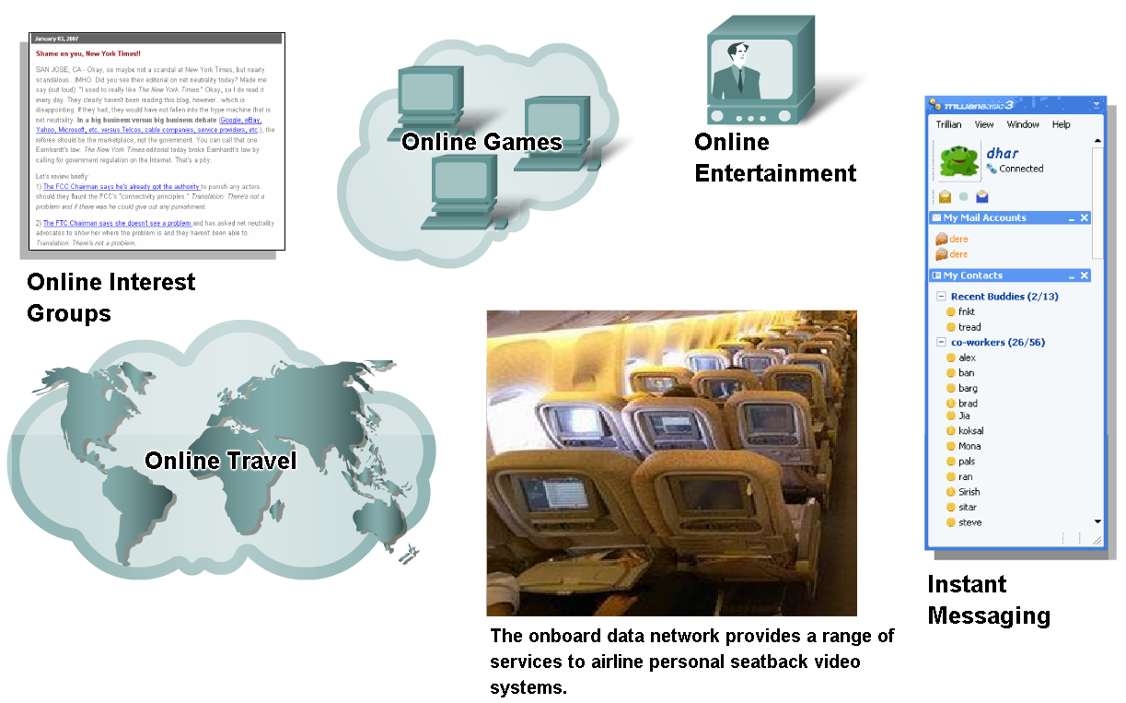
Networks supporting the way we play.

Slide 9
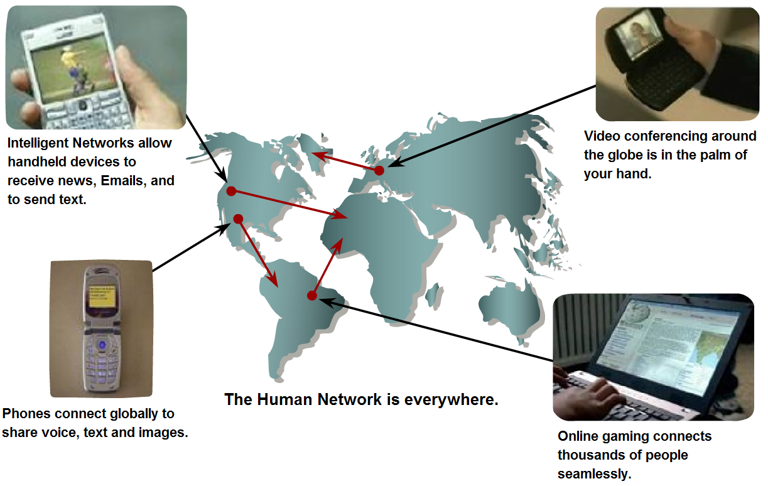
Networks- Purpose???
Communication.

Slide 10



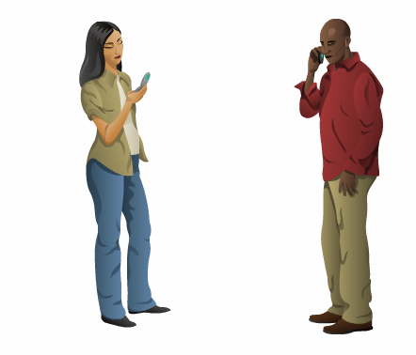
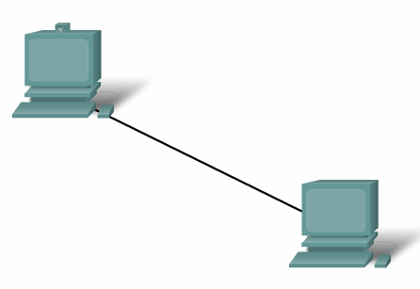

Elements of Communication

Slide 11
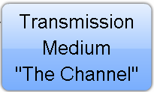




Elements of Communication
What are the elements?

Slide 12
Elements of Communication over Networks
Devices (Sender/Receiver)
These are used to communicate with one another
Medium
This is how the devices are connected together
Messages
Information that travels over the medium
Rules
Governs how messages flow across network

Slide 13
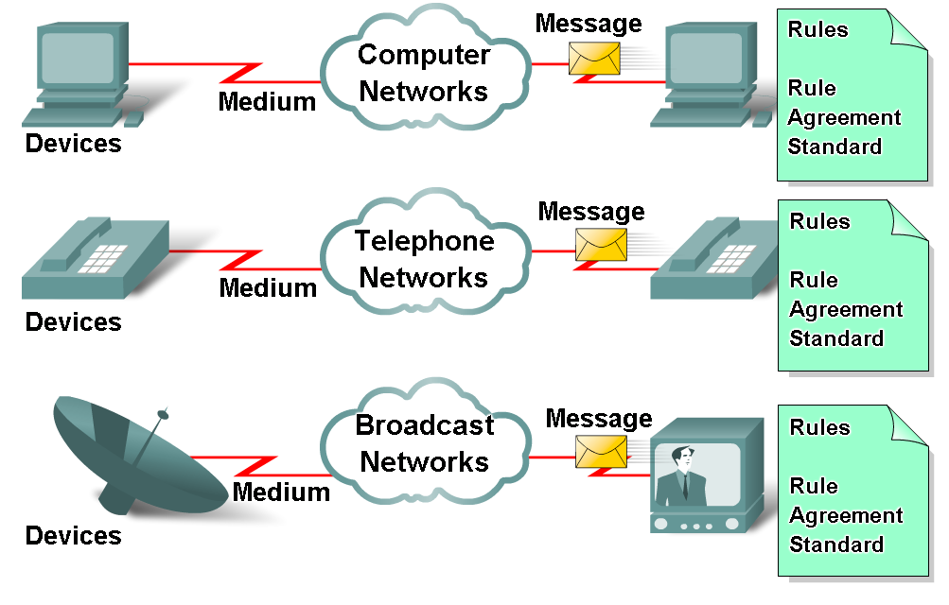
Elements of Communication over Networks

Slide 14
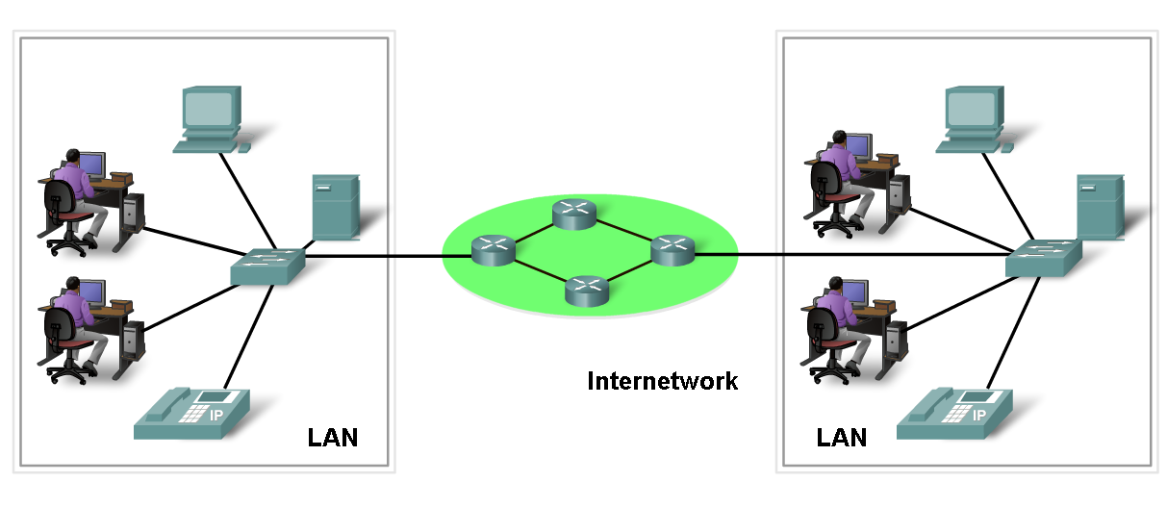
Network Elements/Components
Network Devices
Hardware (Devices and Media)
Software (Services and Processes)

Slide 15
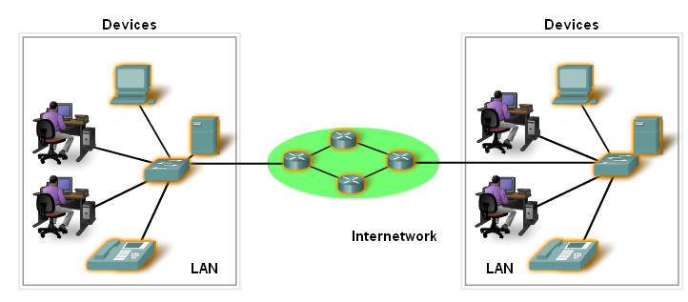
Devices
Two Types:
End Devices
Intermediary Devices

Slide 16
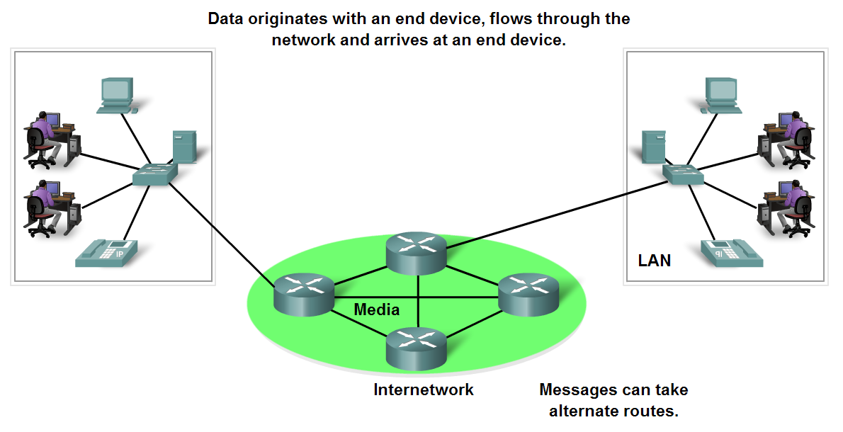
End Devices and their Role
End devices form interface with human network & communications network

Slide 17
Intermediary devices
Provides connectivity between end devices.
Manages data as it flows through the network.
Examples?
Routers
Switches

Slide 18
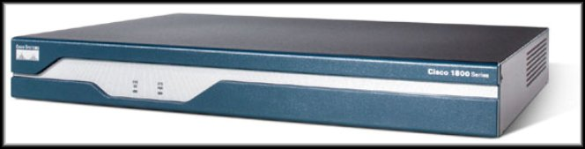
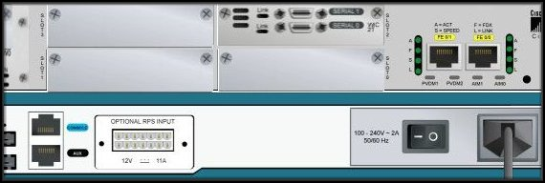
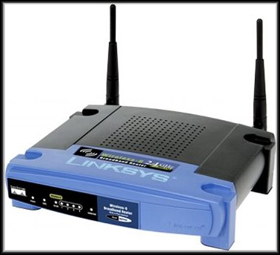

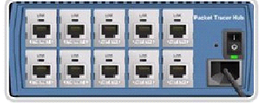
Intermediary devices
Hub
Router
Wireless Router
Switch

Slide 19
Software
Services :
provides information in response to a request.
For example e-mail hosting services and web hosting services.
Processes :
Provide the functionality that directs and moves the messages through the network.
Processes are less obvious to us but are critical to the operation of networks.

Slide 20
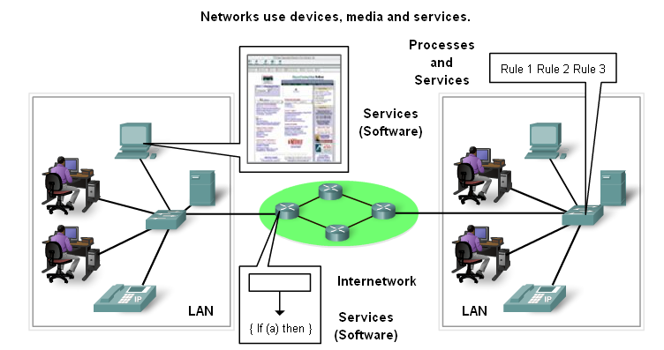
Processes and Services

Slide 21
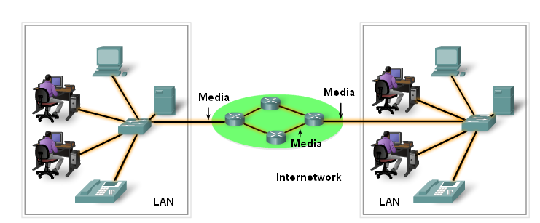
Media

Slide 22
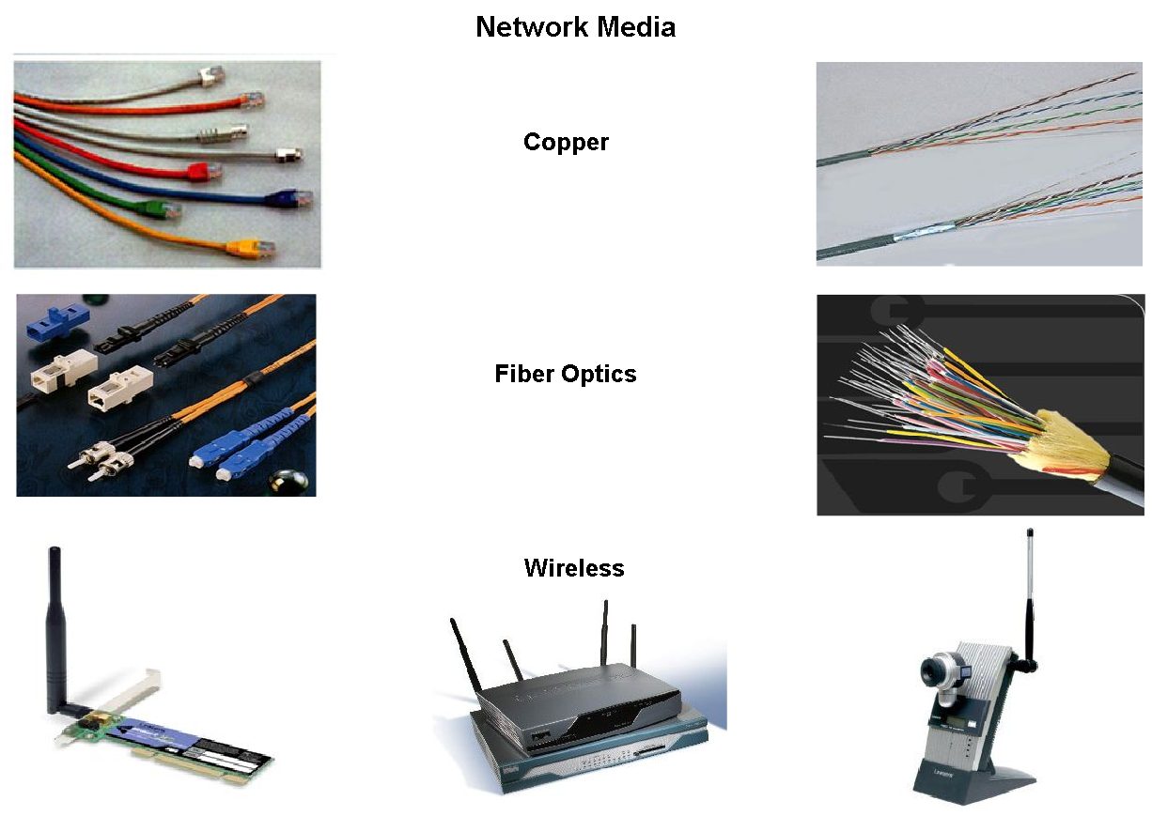
Network Media
The channel over which a message travels

Slide 23
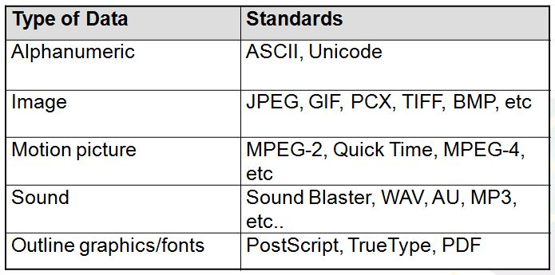
Messages- Data Representation
Information today comes in different forms such as
text, numbers, images, audio, and video.

Slide 24
Data Representation-Text
Text : Different sets of bit patterns are designed to represent text symbols. Each set is called a code.
ASCII
American Standard Code for Information Interchange: 7-bit code/char, 1 bit for parity.
Constitutes the first 127 characters in Unicode and known as basic latin.
Unicode - 16 bit codes to represent a symbol.

Slide 25
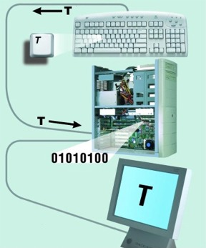
Data Representation-Text

Slide 26
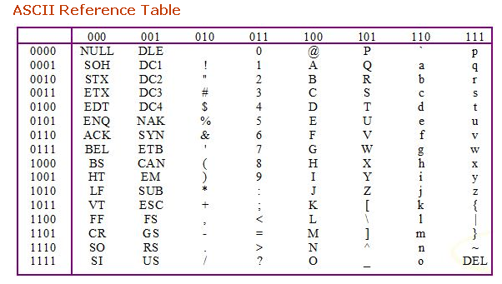
Text- Data Representation

Slide 27
Data Representation- Numbers
Numbers :
Directly converted in to binary which is base 2.
The number 101 in base 2 is really
0 1 1 1 0 1 0 1
2⁷ 2⁶ 2⁵ 2⁴ 2³ 2² 2¹ 2⁰

Slide 28
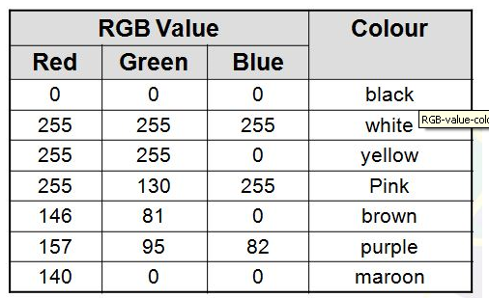
Data Representation
Images –
Also represented by bit patterns.
Mechanism different. Matrix of Pixels used. Each pixel is assigned to a bit pattern.
Color images uses RGB or YCM methods.

Slide 29
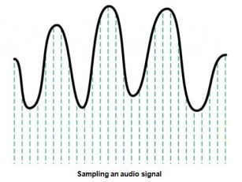
Data Representation
Audio- Continuous, not discrete. Converted to digital or analog signal.
Video – Continuous and discrete entity. Can be changed into analog or digital signal.

Slide 30
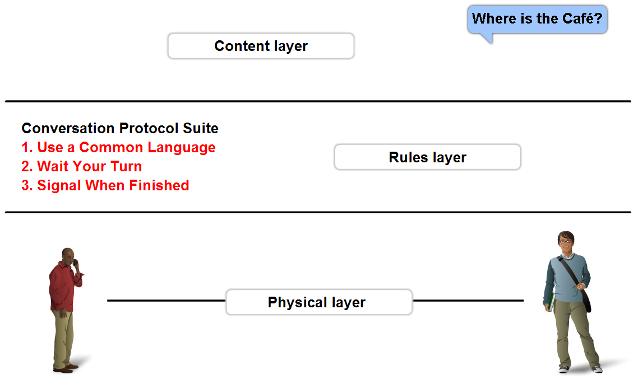
Rules - Protocols
A set of predetermined rules that govern communication.
Defines:
What is communicated??
How it is communicated??
When it is communicated??

Slide 31

Direction of Data Flow
Simplex : Example keyboard, monitors.
Direction of data
Monitor
MainFrame
Half-duplex: Example Walkie Talkies and CB Radios
Direction of data at Time 1
Direction of data at Time 2
WorkStation
WorkStation

Slide 32
Direction of data flow
Full –duplex: Example: Telephone conversation
Direction of data all the time
WorkStation
WorkStation

Slide 33
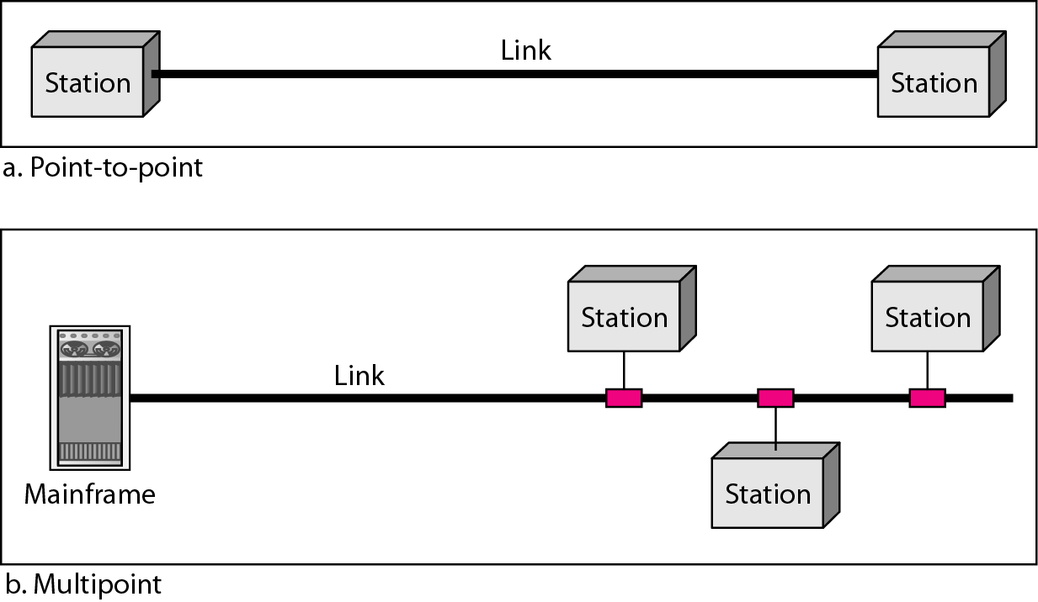
Types of Connection

Slide 34
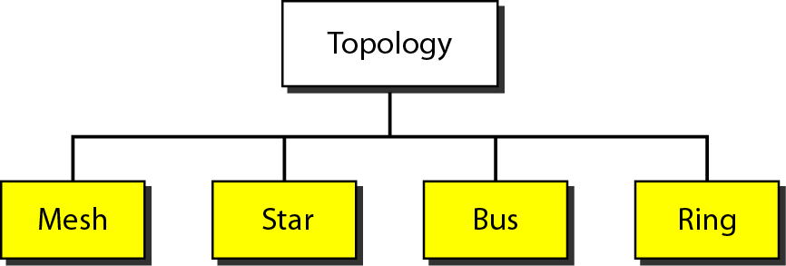
Network Topologies

Slide 35
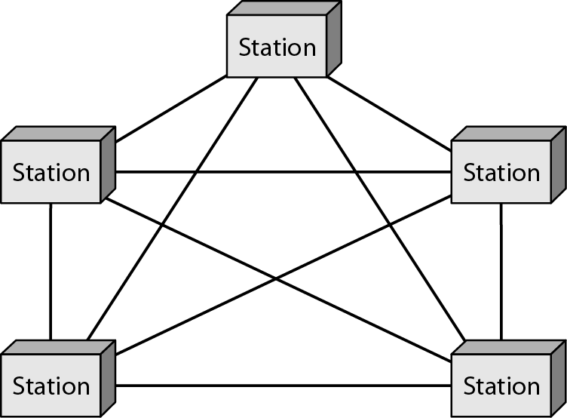
Mesh Topology

Slide 36
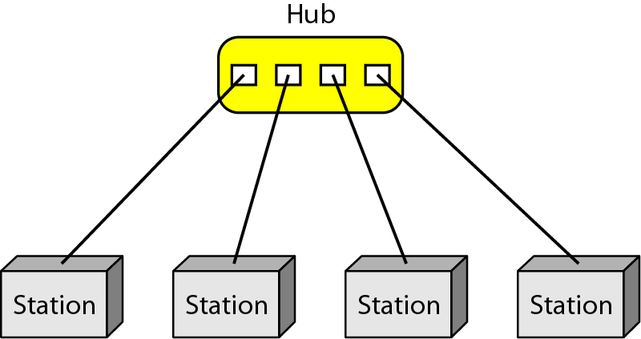
Star Topology

Slide 37
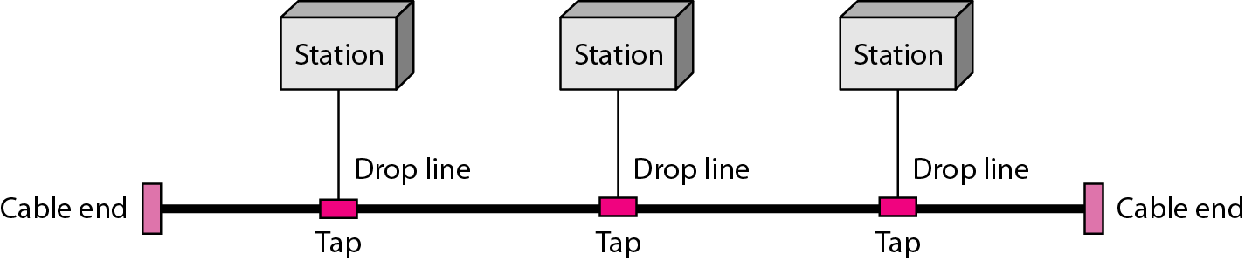
Bus Topology

Slide 38
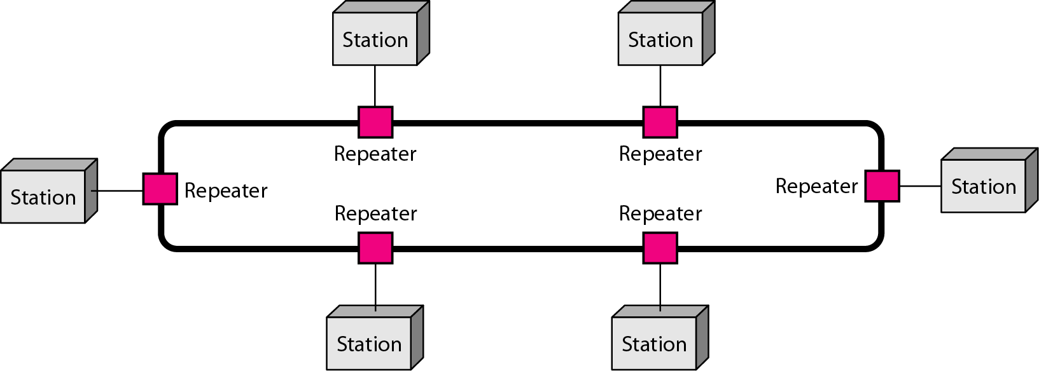
Ring Topology

Slide 39
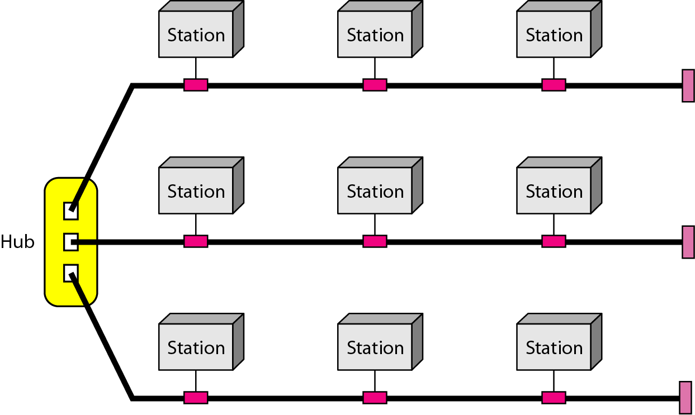
Hybrid Topology

Slide 40
Network Types
PAN
LAN
MAN
WAN

Slide 41
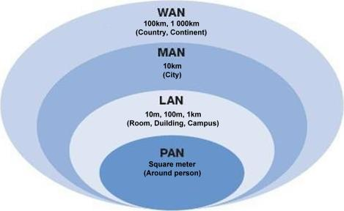
PAN vs LAN vs MAN vs WAN

Slide 42
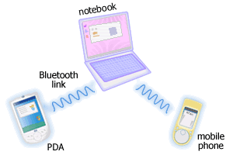
Personal Area Networks (PAN)
A network that connects computers, peripherals and other devices within a personal operating space.
Eg. Bluetooth
http://www.conniq.com

Slide 43
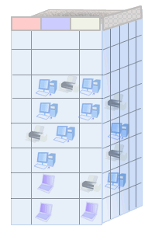
Local Area Networks (LAN)
Usually privately owned
And connects computers, peripherals and other devices within an office, building (e.g. office, home) or campus.
Typical coverage 10m to 1 km.
Ex. Ethernet, Wireless LANs
http://www.conniq.com

Slide 44
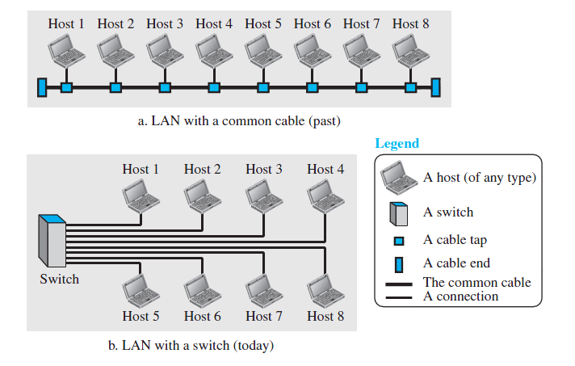
Local Area Networks (LAN)

Slide 45

Metropolitan Area Network (MAN)
Is a city wide network.
The coverage limitation is not strict, but real implementation may have range of up to 50 km in urban, suburban, or rural area.
Ex. WiMax

Slide 46
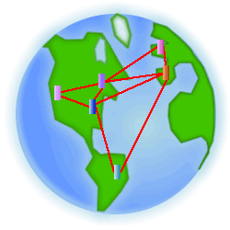
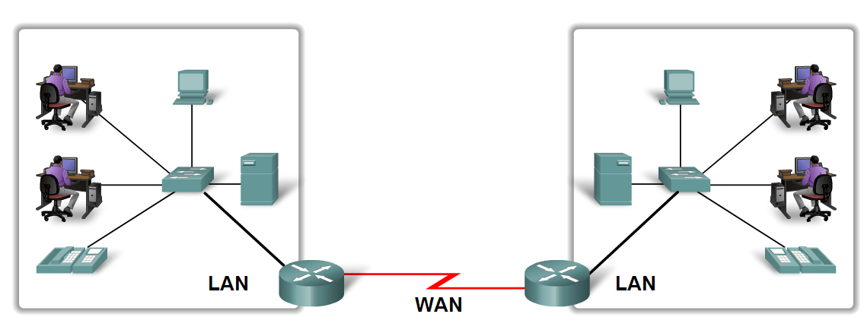
Wide Area Networks (WANs)
A network that spans larger geographical area spanning a state, a country, or even the world.
LANs separated by geographic distance are connected by a Wide Area Network (WAN)
PSTN, Cellular Networks (GSM etc)

Slide 47
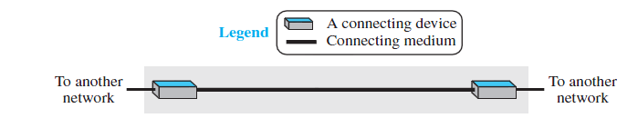
Point-to-Point WAN
A point-to-point WAN is a network that connects two communicating devices through a transmission media (cable or air).

Slide 48
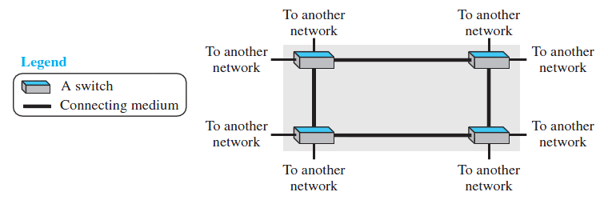
Switched WAN
A switched WAN is a network with more than two ends.
A switched WAN is used in the backbone of global communication today.

Slide 49
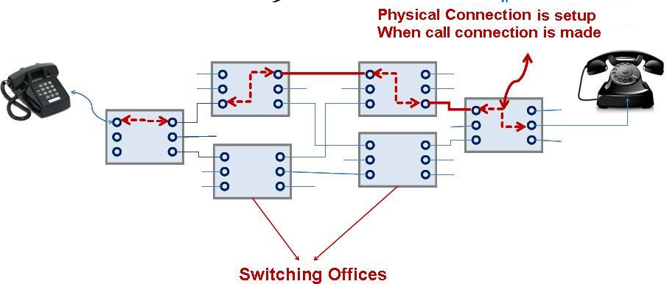
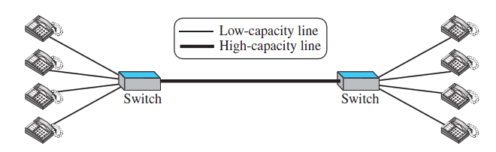
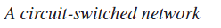
Circuit-Switched Network
In a circuit-switched network, a dedicated connection, called a circuit, is always available between the two end systems

Slide 50
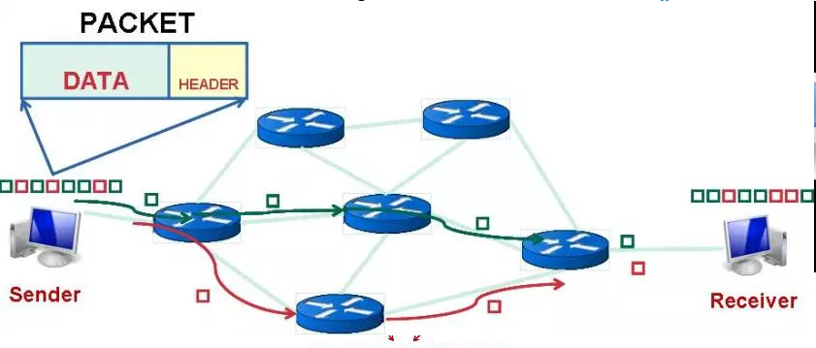
Packet-Switched Network
In a computer network, the communication between the two ends is done in blocks of data called packets.
Instead of the continuous communication there will be the exchange of individual data packets between the two computers.

Slide 51
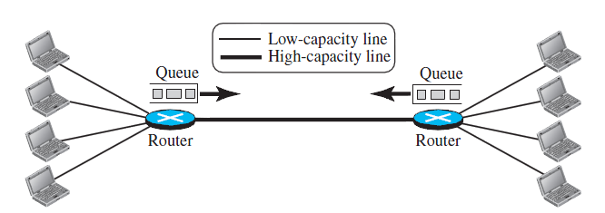
Packet-Switched Network

Slide 52
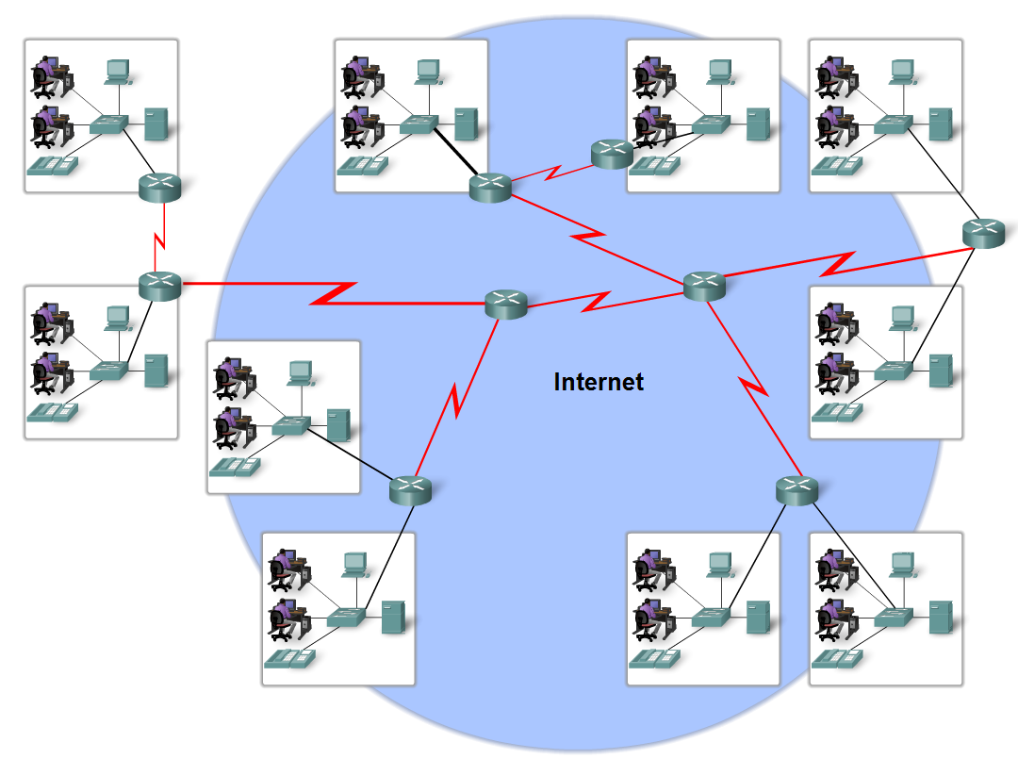
The Internet
The internet is defined as a global mesh of interconnected networks.

Slide 53
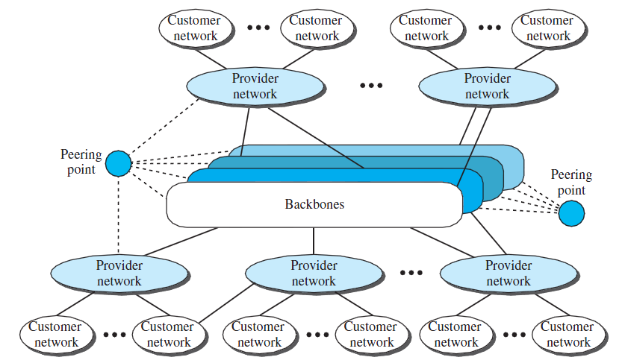
Hierarchical organization of the Internet

Slide 54

Hierarchical organization of the Internet

Slide 55


Accessing the Internet
Using Telephone Networks
Dial-up service.
DSL Service.
DSL Service

Slide 56


Accessing the Internet
Using Cable Networks
Using Wireless Networks
Cable Modem Networks
Wireless Networks

Slide 57
THE END

